Slide 1

LAB EXERCISE 1 (ONE)
Flowchart ASSIGNMENT
Oluwanifemi OYEWOLE

Slide 2
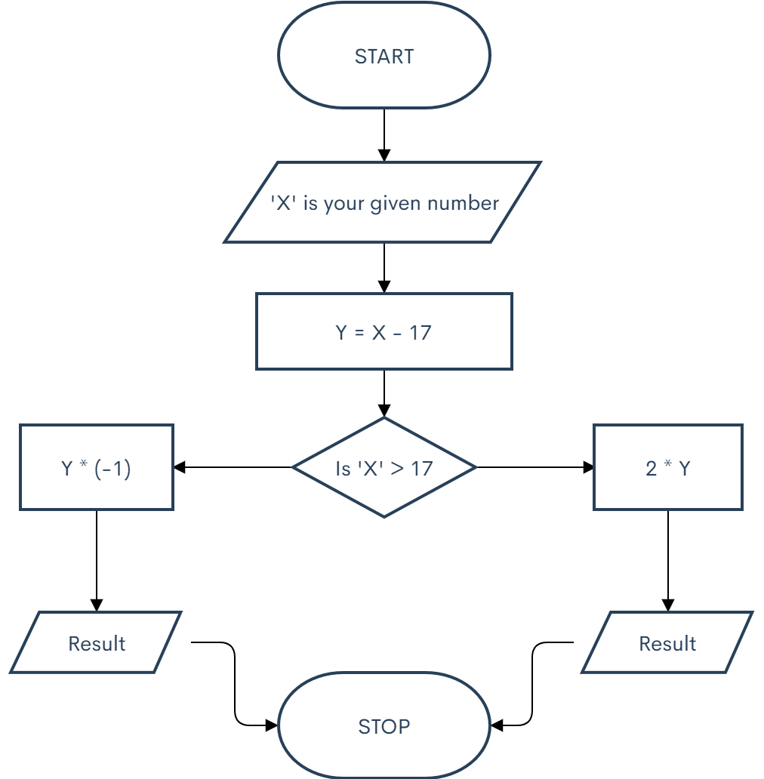
EXERCISE I
The flowchart below shows the order of execution of a program which finds the difference between a given number and 17. If the number is greater than 17, their difference is doubled, but if the given number is less than 17, the output is the absolute value of the operation.
NO
YES
I
II

Slide 3
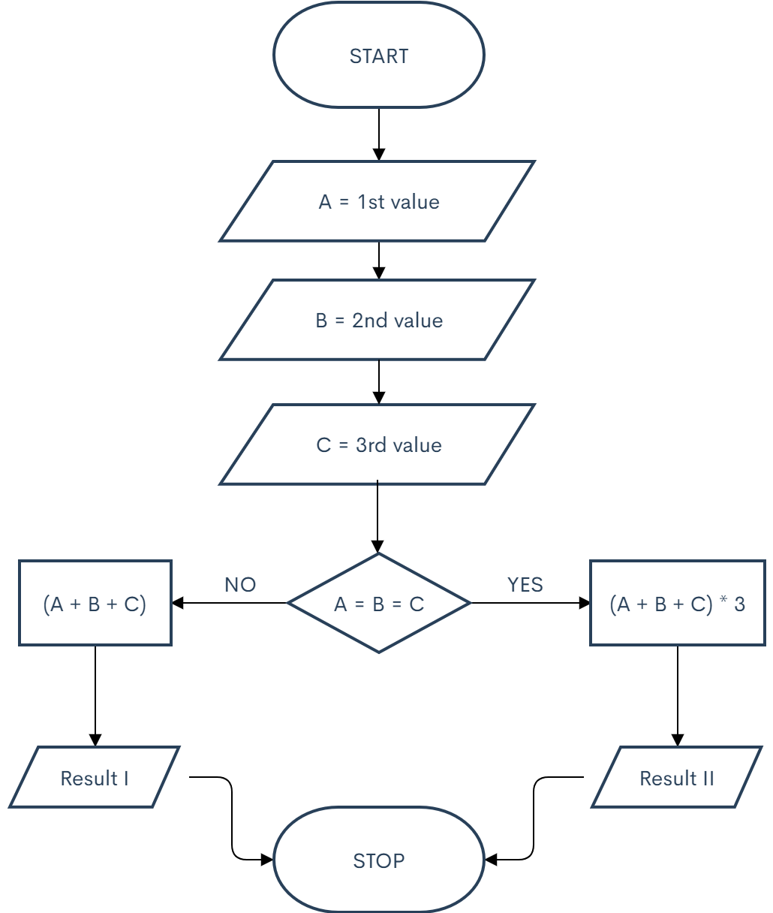
EXERCISE II
The flowchart below shows the order of a program which adds three numbers and multiplies the result by three(3) if the three numbers are the same. If the numbers are different, the values are simply added.

Slide 4
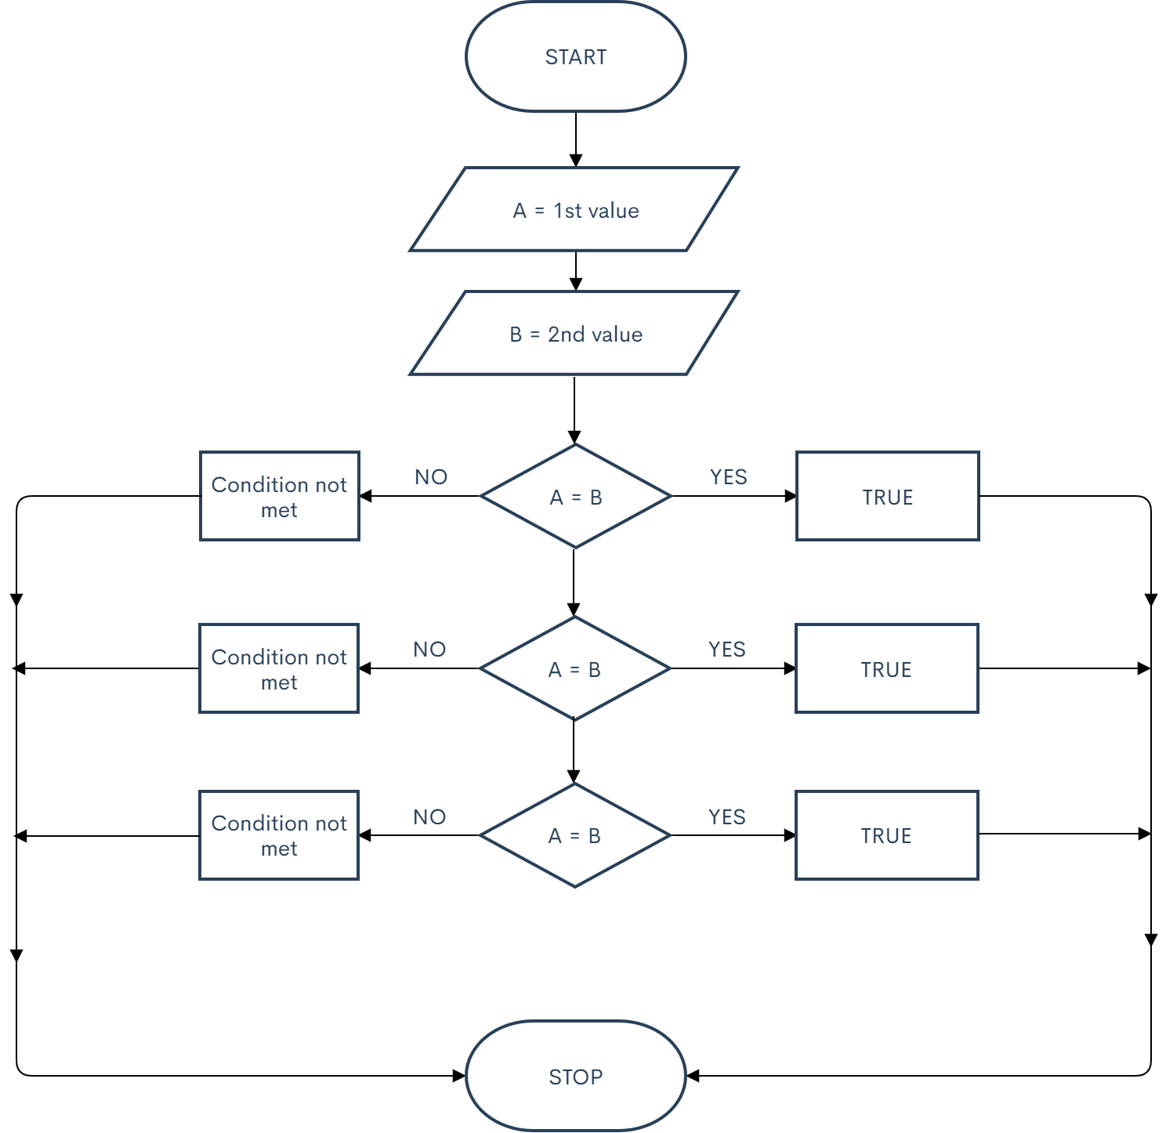
EXERCISE III
This is the flowchart of a program which checks if two values are equal, then it prints TRUE if so. If their sum or difference is equal to five(5) TRUE is printed as well.
Condition not met
TRUE
Condition not met
TRUE
Condition not met
TRUE

Slide 5
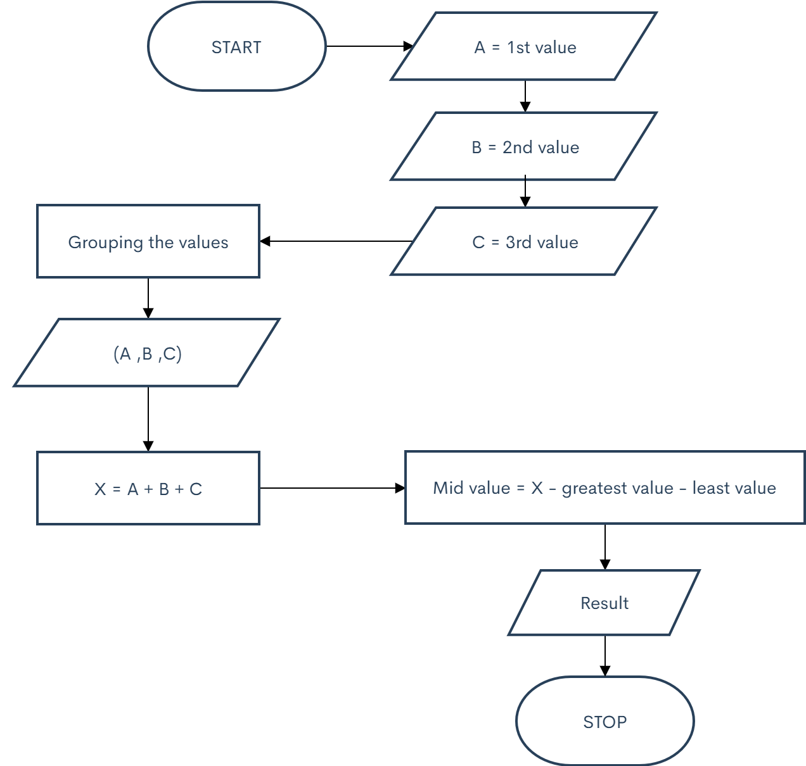
EXERCISE IV
WITHOUT LOOP.
This is the flowchart of a program which sorts integers without using loops or conditional statement.

Slide 6
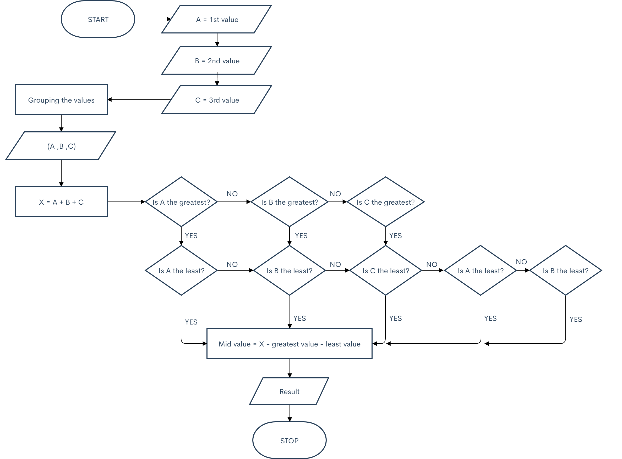
EXERCISE IV
WITH LOOP.
This is the flowchart of a program which sorts integers using loops or conditional statement.

Slide 7
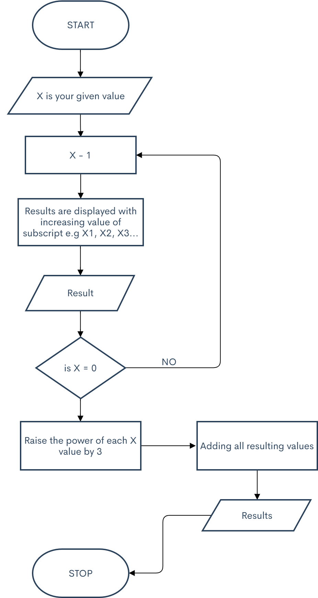
EXERCISE V
This is a flowchart of a function that takes a positive integer and returns the sum of the cube of all the positive integers smaller than the specified number.
YES

